Slide 1

Agentic AI Dynamic Tariff Optimization for EV Charging Networks
Society of Business · Open Project 2026
Presenter: Yash Bansal

Slide 2



Dynamic pricing aligns demand with capacity to increase revenue by +2.8% and off-peak utilization by +15%
Adaptive Engine
State Elasticity
A self-improving, three-agent pricing engine for EV charging that forecasts demand with R² 0.95 accuracy.
Discovers that price elasticity is state-dependent: demand is inelastic during congestion and highly elastic when idle.
Revenue Impact
Policy Learning
Alignment of price with demand earns +2.8% revenue and lifts off-peak charging by +15% at revenue-neutral averages.
Monitoring agents treat tariffs as a revenue tool, improving composite objective scores from 6.5 to 20.2.

Slide 3

A unified dataset from Caltech and Shenzhen charging networks provides the foundation for data-driven modeling
Unified Panel: 279k rows of hourly station data mapping occupancy to energy flows.
ACN (Caltech/JPL): 14,999 clean sessions used for workplace charging signature analysis.
UrbanEV (Shenzhen): 247 grids featuring real time-varying prices and dynamic pricing flags.
Key Features: Utilization rates, energy cost/kWh, queue proxies, and occupancy density.

Slide 4
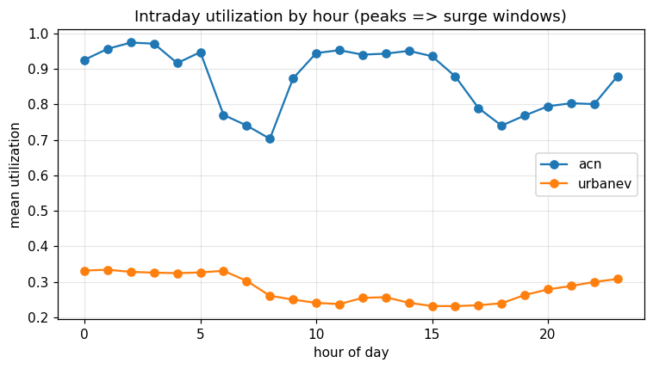


Charging networks are primarily under-utilized with occupancy peaking overnight
Counter-intuitive Finding: Charging occupancy peaks overnight (hours 0–1, 6), shifting the focus to off-peak capacity.
Idle Capacity: Mean network utilization is only 28%. The dominant opportunity is filling the 72% idle average.
Agent Strategy: Pricing is based on realized utilization states, not static clock-based assumptions.

Slide 5

LightGBM models forecast charging utilization with high accuracy (R² 0.95) for urban grids
Data Source | Model R² | Baseline R² (Seasonal) | Model RMSE
UrbanEV (Grid) | 0.95 | 0.74 | 0.040
ACN (Workplace) | 0.28 | 0.10 | 0.219
Forecasting accuracy at the grid level provides the agent with reliable state probabilities for price setting.
Note: Urban networks show high predictability compared to more volatile workplace session logs.

Slide 6


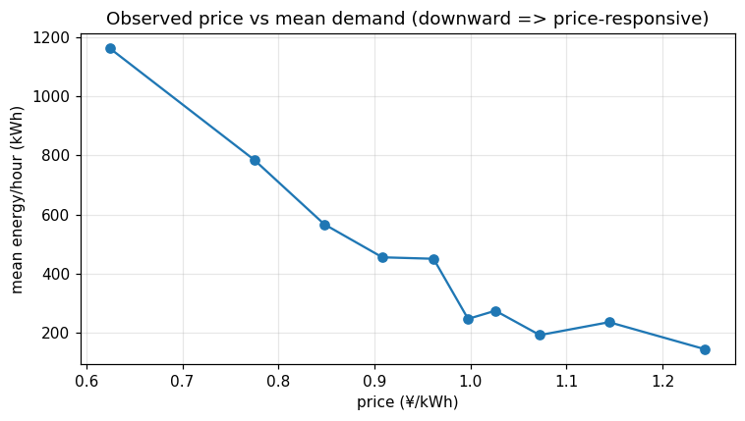
Price elasticity is state-dependent: demand is elastic when idle and inelastic during congestion
q = q₀ · mε(state)
Utilization State | ε (Elasticity) | Behaviour
Off-peak (Idle) | -0.51 | Elastic → Discounts grow volume
Mid-Level | -0.13 | Moderate sensitivity
Busy / Congested | ≈ 0.00 | Inelastic → Surge captures revenue

Slide 7

Demand-responsive tariffs generate +2.8% revenue and +15.3% off-peak lift without raising average price
Operating Point | Avg Price Factor | Revenue vs Flat | Off-peak Uplift
Flat baseline | ×1.00 | 0% | —
Revenue-neutral (Core) | ×1.00 | +2.8% | +15.3%
Full Learned Policy | ×1.20 | +20.5% | +6.1%
Honest Limitation:
Surge pricing does not reduce peak occupancy significantly. The primary grid lever is attracting demand to off-peak periods.

Slide 8
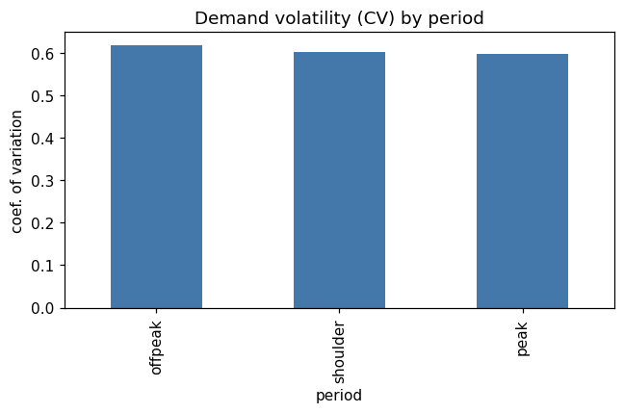
Monitoring agents rapidly tune pricing policies to optimize the revenue-access balance
Agentic Feedback: Monitor scores every decision to tune surge/discount sensitivity (Score 6.5 → 20.2).
Learned Inelasticity: The loop confirms peak demand is inelastic, allowing for effective revenue capture.
Dynamic Lever: Price scarcity by demand state rather than clock-based schedules.
Grid Health: Discounts serve as a tool for grid health and off-peak volume growth.

